Slide 1
SharePoint APIs
PnP JS v2

Slide 3
How to View This Presentation
To switch to Notes Page view:
While in edit mode, click the View tab within the ribbon, and then click Notes Page
To navigate through notes, use the Page Up and Page Down keys
Zoom in or zoom out, if required
In the Notes Page view, you can:
Read any supporting text—now or after the delivery
Add notes to your copy of the presentation, if required
Take the presentation files home with you

Slide 4
Overview
What is PnP JS
In this Lesson
How to use PnP JS
When to use PnP JS
Advanced PnP JS Scenarios
Samples using PnP JS

Slide 5
Objectives
Learn what PnP JS is
Know when to use it for your customizations
Discover how it can be used
Get familiar with advanced techniques

Slide 6

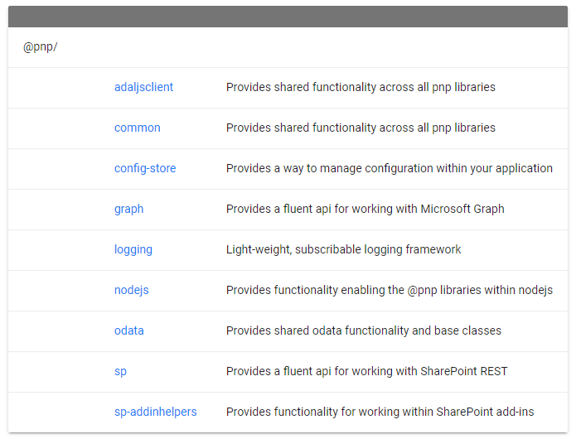
What is PnP JS
JavaScript framework based on ECMAScript 6
Open Source under MIT license
Uses Promises
Retrieves data through the SharePoint & Graph APIs
Takes away the need to know the REST URL syntax
Offers built-in batching and caching
Consists out of 9 smaller libraries https://pnp.github.io/pnpjs/packages /
Notes:
The Patterns and Practices JavaScript Core Library was created to help developers by simplifying common operations within SharePoint and the SharePoint Framework. Currently it contains a fluent API for working with the full SharePoint REST API as well as utility and helper functions. This takes the guess work out of creating REST requests, letting developers focus on the what and less on the how.
Licensed under MIT means it can freely be used for any purpose, both commercial as well as private without having to pay any fees as long as the original disclaimer is copied along in the code.
The framework fully uses promises to aid in the asynchronous behavior of JavaScript to ensure code is only execute after the necessary data has been retrieved. It leverages the Promises feature in ECMAScript 6 which is unfortunately not supported in all browsers. More on that later.
It uses the SharePoint REST API at _api along with the Microsoft Graph API to retrieve the data.
The advantage is that you don’t need to mess with things like the plumbing around communicating with the REST API, error handling, caching, knowing the exact REST URLs and OData syntax to retrieve information.
The PnP JS framework has built in support for batching multiple requests into one to speed up the data loading times saving the need to make several independent requests.
It also offers built in caching to avoid having to make the same request multiple times, even across different pages and sessions.
In January 2020 PnP JS version 2 has been released which further optimizes the amount of code needed to communicate with JavaScript. Based on what functionality you need, you add the packages, based on what functionality you need within a package, you specify imports. WebPack will take care of finding only the specific code needed to perform your operations and will only bundle that small subset into the JavaScript file that gets compiled by the Gulp task for the SharePoint Framework. PnP JS is entirely based on TypeScript.

Slide 7
When to use PnP JS
Developing customizations that render in a page
Page visits tracker, modifications to the out of the box DOM, taking actions based on current user permissions, rendering results of a search query
When developing a SPFx component which interacts with SharePoint
When you intended to use the SharePoint JavaScript Object Model (JSOM)
Notes:
If you’re looking to develop customizations inside SharePoint which render inside a page, i.e. a page visits tracker, modification of the DOM to add something to the out of the box SharePoint experience, PnP JS is an excellent choice. For example when injecting JavaScript into every page through a JavaScript CustomAction ScriptLink in non modern sites, you could use this library.
When using SPFX Components which need to interact with SharePoint, using PnP JS also has advantages like not needing to define the exact REST URL, built in caching and batching and access to property storage within the framework.
Or if you simply can’t use the SharePoint Framework because i.e. you’re using SharePoint 2013 still, you can utilize PnP Core JS to communicate from JavaScript with SharePoint. Yet even when using the SharePoint Framework, you can utilize PnP JS in it as well.
The native SharePoint JavaScript Object Model (JSOM) is not being invested in anymore by the product group as announced at Microsoft Ignite 2017, so refrain from using that and use PnP JS instead. Public statement on this:
https://docs.microsoft.com/en-us/sharepoint/dev/spfx/web-parts/guidance/connect-to-sharepoint-using-jsom#considerations

Slide 8
How to use PnP JS
PnP JS v2 in TypeScript (1/2)
npm install @pnp/sp @pnp/graph
import { sp } from "@pnp/sp"; import "@pnp/sp/webs";
(function main() {
// here we will load the current web's title sp.web.select("Title").get().then(w =>
console.log(`Web Title: ${w.Title}`);
});
})()
Notes:
To use PnP JS v2 TypeScript, you need to perform the following steps:
Add the minimal required PnP JS v2 packages to your solution using Node Packet Manager (NPM): npm install @pnp/sp @pnp/graph
Add the import statement to the TypeScript file: import { sp } from “@pnp/sp"; This will make the pnp library available in that .ts file. New in PnP JS v2 is the ability to import a really specific type: import "@pnp/sp/webs"; This will ensure WebPack will only take and compile the SPWeb object and put it into the eventual bundle. This to create a smaller JavaScript file in the end.
More information:
https://pnp.github.io/pnpjs/getting-started

Slide 9
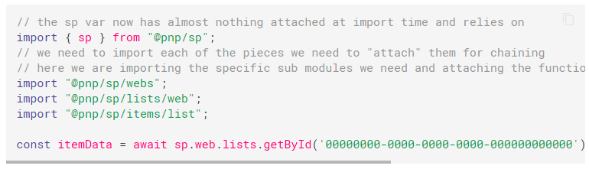
How to use PnP JS
PnP JS v2 in TypeScript (2/2)
Selective imports make the bundle smaller
Import specifically which type(s) you want to use
Notes:
New with PnP JS v2 is the ability to do specific type imports. This causes WebPack to be able to identify specific types which are being used and include only those in the eventual JavaScript bundle making it much smaller. You still need to import @pnp/sp, but that’s a relatively smaller subset of code.
Notice the format of the selective imports. Doing @pnp/sp/lists/web means we’re only loading the lists type located under the webs object. The @pnp/sp/webs object loads in the webs object of the site you’re connected with. To help with finding which selective imports you need, consult the documentation, such as for list items: https://pnp.github.io/pnpjs/sp/items/ . Here you will see at the top of the page which selective imports you will need to do in order to use the functionality. The preset all option shown on the page is the fallback option which will import all available types thus making the JavaScript bundle unnecessary large but not bothering you with trying to figure out the correct selective imports. It should be used as a very last option resort only.
For more information, see:
https://pnp.github.io/pnpjs/concepts/selective-imports/
https://pnp.github.io/pnpjs/sp/items/

Slide 10
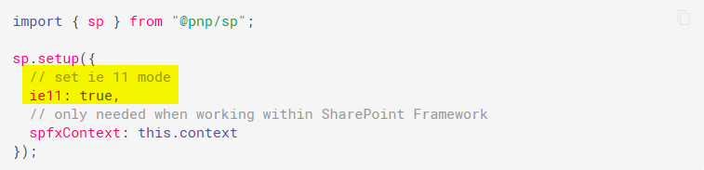
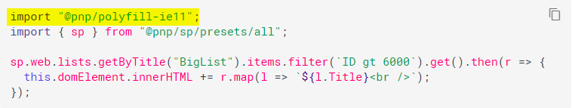
How to use PnP JS
PnP JS v2 with Internet Explorer 11
Support for Internet Explorer 11 has been dropped in v2
npm install @pnp/polyfill-ie11 --save
Notes:
In PnP JS v2, support for Internet Explorer has been dropped. This means that PnP JS v2 cannot be used in Internet Explorer 11 without taking extra steps. The foremost recommendation is to switch to a newer browser, such as Edge Chromium. If you really still have to support Internet Explorer 11, you can add the NPM package @pnp/polyfill-ie11 to your project. Next to that, you need to enable ie11 support in the sp.setup section as shown on this slide and need to add the import “@pnp/polyfill-ie11” to every TypeScript file.
More information on this:
https://pnp.github.io/pnpjs/concepts/ie11-mode/
https://pnp.github.io/pnpjs/concepts/polyfill/

Slide 11
How to use PnP JS
PnP JS v2 with SharePoint 2016 or 2019
SPFx 1.4.1 uses TypeScript version 2.2.2 (SP2016) or 2.4.2/2.4.1 (SP2019)
PnP JS v2 relies on TypeScript version 3.6.4 or later
Upgrade TypeScript in SPFx to allow use of PnP JS v2 https://pnp.github.io/pnpjs/SPFx-on-premises/
Notes:
If you want to use PnP JS v2 with an on-premises SharePoint 2016 or SharePoint 2019 farm, you will be stuck with using SPFx version 1.4.1. In this SPFx version, an older TypeScript version is being used which is not compatible with PnP JS v2. You have to follow some easy steps in order to upgrade the TypeScript version in your SPFx project to make it work with PnP JS v2. The site shown on this slide will detail how to accomplish this.

Slide 12
Knowledge Check
Does PnP JS use JSOM
Yes
No
In which browser does PnP JS require extra libraries
FireFox
Chrome
Internet Explorer
Microsoft Edge

Slide 13
Knowledge Check
Does PnP JS use JSOM
Yes
No
In which browser does PnP JS require extra libraries
FireFox
Chrome
Internet Explorer
Microsoft Edge
Notes:
PnP JS leverages the REST API underneath, not JSOM. So if JSOM is to disappear some time in the future, it will not break PnP JS.
For Internet Explorer, polyfills need to be added and IE11 mode needs to be enabled before it will work.

Slide 14
Typical PnP JS flow
Add PnP JS NPM packages
Build command chain
Implement promises handlers
Use retrieved data
Notes:
This slide shows the steps you typically go through to retrieve data from SharePoint using PnP JS. You first add the NPM packages of the PnP JS components you want to use. Then you’ll build a command chain to get the data you need or perform the operation you wish to perform. You implement the promises .then and .catch handlers to deal with a success and failing outcome. Once you have the data, you can use it for whatever you need.

Slide 15
PnP JS Code Sample – Reading data
import { sp } from "@pnp/sp";
import "@pnp/sp/webs";
sp.web.select("Title")()
.then(web => { document.getElementById("main")
.innerText = web.Title;
});
Notes:
This TypeScript sample shows how to read the title from the current web and assign it to the HTML element with the ID main.

Slide 16
PnP JS Code Sample – Writing data
import { sp } from "@pnp/sp";
import "@pnp/sp/webs";
import "@pnp/sp/lists";
import "@pnp/sp/items";
import { IItemAddResult } from "@pnp/sp/items"; const iar: IItemAddResult = await sp.web.lists.getByTitle("Tasks").items.add(
{
Title: "Update PnP JS library",
Body: "Who will do this?"
});
console.log(iar);
Notes:
This JavaScript sample shows how to add a new item to a list called Tasks and set the title and its description.
More information:
https://pnp.github.io/pnpjs/sp/items/

Slide 17
Advanced PnP JS Scenarios
Batching
Instantiate a batch variable
Chain the batching to the request you wish to make using inBatch(batchvariable)
Execute the batch using batchvariable.execute()
let batch = sp.createBatch();
sp.web.lists.inBatch(batch).get().then(r => { console.log(r) });
sp.web.lists.getByTitle("Tasks").items.inBatch(batch).get().then(r => { console.log(r) });
batch.execute().then(() => console.log("All done!"));
Notes:
Batching means performing 1 request towards SharePoint to fetch multiple data results in one time. This makes the processing faster, more efficient and limits chances to be throttled by SharePoint. You can combine batching GET and POST requests. I.e. retrieving items and adding items.
To utilize batching, perform these steps:
Instantiate a batch variable: let batch = sp.createBatch();
Chain inBatch to the command you wish to execute. It needs to be the last command in the chain: sp.web.lists.inBatch(batch).get()
Execute the batched commands all at once using: batch.execute().then(() => console.log("All done!"));
More information: https://pnp.github.io/pnpjs/odata/caching/#using-batching-with-caching

Slide 18
Advanced PnP JS Scenarios
Caching
Chain usingCaching to the request you wish to make
Execute the command as normal
import { sp } from "@pnp/sp"; const r = await sp.web.lists.getByTitle("Tasks").items.top(5).orderBy("Modified") .usingCaching({
expiration: util.dateAdd(new Date(), "minute", 20),
key: "My Key",
storeName: "local" // or session
});
console.log(r);
Notes:
Caching allows subsequent requests for similar data to be cached in the browser so no actual request towards SharePoint is needed anymore. This makes the page faster and offloads the SharePoint APIs.
To utilize caching, perform these steps:
Just add the usingCaching command to the chain as the last element before get(). If you don’t provide any arguments, the defaults are being applied which are 30 seconds duration of the cache stored in the session cache
Execute the command as normal
Every time the same chained request is made, the PnP Core JS framework will first check if it still holds a valid cache for that data and if so, return the cached value. The developer doesn’t notice the difference if the data came live from SharePoint or from the cache.
Local cache means the cached data is kept even after closing the browser. Session cache means the cached data is deleted when the user closes the browser.
If using both batching and caching, it doesn’t matter which of these two commands is last in the command chain.
More information: https://pnp.github.io/pnpjs/odata/caching/#basic-example

Slide 19
Knowledge Check
What are selective imports for in PnP JS v2
Can you update content with PnP JS v2
Can you use Caching and Batching in the same request
Can you elevate to more rights than the current user has in PnP JS
Allows WebPack to only bundle those types that you are using. Causes the JavaScript bundle to become smaller.
Yes, just call Update({ Title: ‘My new title’, Description: ‘My new description })
Yes, just chain .usingCaching().inBatch()
No, as JavaScript always runs in the current user its context
Notes:
Documentation on using batching and caching together:
https://pnp.github.io/pnpjs/odata/caching/#using-batching-with-caching

Slide 20
Lesson Summary
PnP JS leverages the SharePoint REST APIs
PnP JS allows using the REST APIs without knowing the exact URL syntax
PnP JS offers easy to use optimization options through batching and caching

Slide 21
Questions?

Slide 22
Lab: Working with PnP JS
In this lab, you will learn how to add PnP JS to your page and use it to retrieve and display data through the SharePoint API
Time estimation: 15 minutes
Notes:
Lab content can be found under “Lab - Working with PnP JS”

Slide 23
PnP JS Samples
Using Search
import { sp } from "@pnp/sp";
import "@pnp/sp/search";
import { ISearchQuery, SearchResults, SearchQueryBuilder } from "@pnp/sp/search"; const results: SearchResults = await sp.search(<ISearchQuery>{
Querytext: "test",
RowLimit: 10,
EnableInterleaving: true,
});
console.log(results.ElapsedTime);
console.log(results.RowCount);
console.log(results.PrimarySearchResults);
Notes:
More information:
https://pnp.github.io/pnpjs/sp/search/

